Slide 1

High Performance Network Metadata Extraction Using P4 for ML-based Intrusion Detection Systems
Nicholas Gray, Katharina Dietz, Michael Seufert, Tobias Hoßfeld

Slide 2



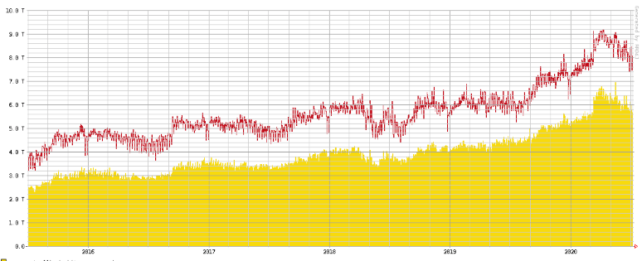
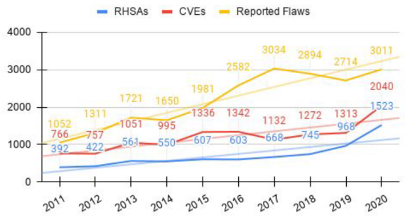


Motivation
Recent trends:
New device categories: mobile devices, wearables, IoT sensors, …
New applications: streaming services, cloud gaming, ...
New traffic patterns
Consequences:
Increased network load and complexity
More sensitive data is exchanged
Cyber attacks become more frequent
The Growth in Connected Devices is Expected to Generate 79.4ZB of Data in 2025
The Amount of Reported Flaws has Trippeled within the last 10 Years
→ Security solutions need to keep pace

Slide 3
Motivation
External Network
Internal Network
Existing solutions do not scale very well
Metadata Extraction
Analysis
IDS
Increase scalability with P4
Reduce complexity with ML-enabled analysis
External Network
Internal Network
P4
Metadata Extraction
ML
Analysis
IDS

Slide 4
Why P4?
P4 is a target- and protocol-independent programming language, deploys on programmable switch chips
Allows to control the data plane arbitrarily within the scope of the language/hardware, i.e. to reconfigure forwarding tables and logic
Packet processing through P4-enabled switch chips is as fast as through fixed-function ASICs → Extraction of metadata can be achieved at line rate
Experimental implementations of metadata extraction already exist (e.g. INT), however they are not tailored to a security context
Ingress Pipeline
Egress Pipeline
Match Action
Queues and/or Buffers
Match Action
Input
Parser
Deparser
Output
Ingress Match+Action
Packet Modification + Egress Selection
Egress Match+Action
Packet Modification

Slide 5
Research Questions
Which features can be extracted using a P4-based solution and which level of aggregation is possible?
How does the proposed solution perform in terms of throughput, performance gain, accuracy, false positives and in comparison to existing solutions?
Which features are useful for a security-related metadata analysis?

Slide 6
System Design
Goal: Classification of traffic into benign or malicious
Switch Application Limits (P4 + Tofino):
Packet-based pipeline architecture
No periodic or batch operations
Limited amount of stateful data structures
Only certain arithmetic operations possible
Constraints due to chip design
Controller Application
Receiver Application
Detection Application
Control Plane
Metadata Packets
Analysis File
Memory Access
Metadata Packets
Data Plane
Switch Application
Host
…
Host
…
Host

Slide 7
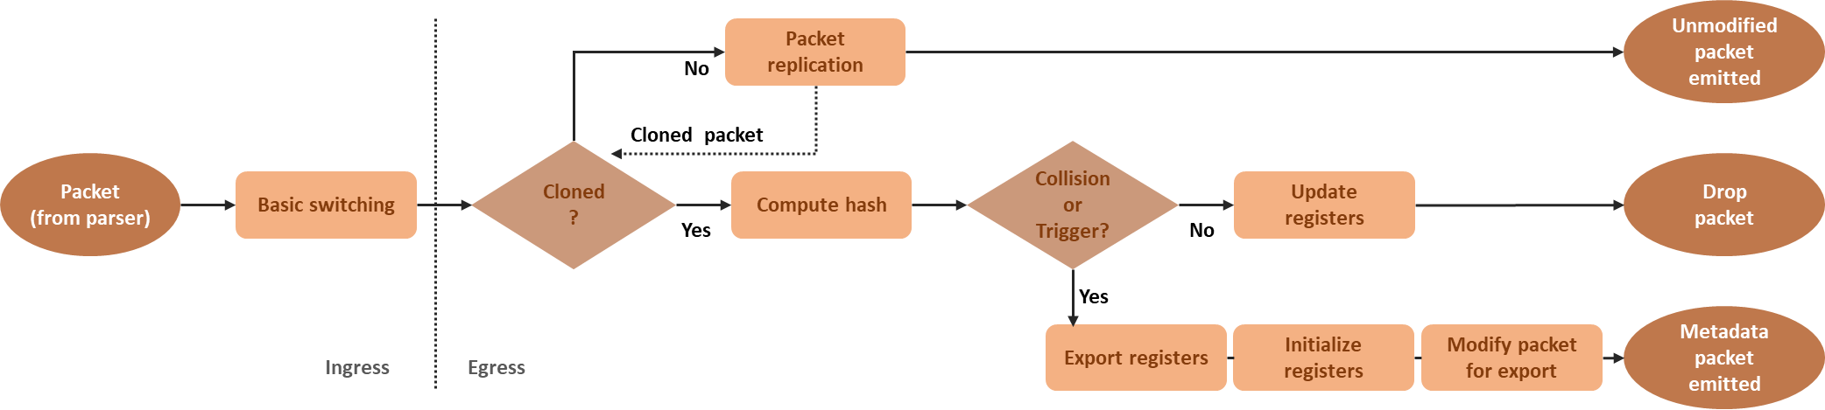
Metadata Extraction
Program flow of Switch Application
Extraction of expired flows is handled by Controller Application
Export registers
Initialize registers
Send Packet
8

Slide 8
Metadata Features
Overall, 27 individual flow-based features are extractable
As hardware resources are limited, a subset of 15 features (*) for 2^16 concurrent flows has been chosen

Slide 9
Attack Scenarios
For the later evaluation, the CICIDS2017 evaluation dataset is used (Canadian Institute for Cybersecurity / University of New Brunswick)
5 weekday files, each ~10 GB, ~11M packets, ~500K flows PCAP + flow-based labels
Focused on Tuesday trace:
Port Scans
Brute Force attacks (FTP + SSH)
DoS attacks (e.g. slowhttptest)
DDoS attacks

Slide 10
Evaluation - Overview
Processing Speed
Attack Detection
Host 2
Receiver App.
Offline Host
Metadata Analyzer
Compression
100G
100G
Tofino P4 Switch
Switch App. Controller App.
Tofino P4 Switch
Switch App. Controller App.
Host 1
Traffic Source
100G
100G
Throughput

Slide 11
Evaluation - Overview
At least 7Gbps
Processing Speed
Attack Detection
Host 2
Receiver App.
Offline Host
Metadata Analyzer
Compression
100G
100G
Tofino P4 Switch
Switch App. Controller App.
Tofino P4 Switch
Switch App. Controller App.
Host 1
Traffic Source
100G
100G
Throughput
~98Gbps

Slide 12
Compression of the P4 Switch Application
Which compression does the switch achieve through the flow-based aggregation of metadata in its internal registers?
PCAP replay from CICIDS2017 dataset
Input: ~11.7M packets, ~10,4 GB
burst
realtime

Slide 13
Evaluation - Overview
At least 7Gbps
Processing Speed
Attack Detection
Host 2
Receiver App.
Offline Host
Metadata Analyzer
Compression
100G
100G
Tofino P4 Switch
Switch App. Controller App.
Tofino P4 Switch
Switch App. Controller App.
Host 1
Traffic Source
100G
100G
Throughput
~98Gbps

Slide 14
Attack Detection Rate
Machine Learning Model based on Random Forest Algorithm (Scikit-learn)
Metadata file generated by receiver is pre-processed for ML (labeling, removal of IP adresses etc.), then used as input
75% used as training set (randomized search with k-fold validation for hyperparameter tuning)
25% used for validation
Suricata configured with specific sections of Emerging Threats Open

Slide 15
Comparison and Conclusion
Due to recent trends, existing IDS solutions reach their limits. P4- and ML-based solutions can contribute to solve existing challenges
This work designed, implemented and evaluated a P4-based metadata extraction in a security-related context
100 Gbit/s traffic has been compressed to a ~3 Gbit/s metadata stream, while still being able to classify flows with 99.70 % balanced accuracy
Future work:
Live analysis and therefore earlier classification
Additional attack scenarios

Slide 16



Thank you for your Attention
Questions
Links
Contact
nicholas.gray@uni-wuerzburg.de
katharina.dietz@uni-wuerzburg.de
michael.seufert@uni-wuerzburg.de
https://www.informatik.uni-wuerzburg.de/comnet/
?
https://github.com/lsinfo3/P4FeatureExtraction_HPSR2021
?
?

Slide 17
Throughput

Slide 18
Receiver Application
Which processing speed does the receiver application achieve?
PCAP replay of metadata stream via tcpreplay (limited to 7 Gbit/s)
Performance of the receiver application: up to 7 Gbit/s of metadata traffic without packet loss
Network performance verdict:
Raw traffic of 100 Gbit/s is compressed to ~3 Gbit/s by the switch
Receiver application is able to handle up to 7 Gbit/s
→ Entire system is able to handle 100 Gbit/s of raw traffic

